Slide 1


Appcelerator Titanium Introduction to cross-platform mobile development
with Tim Poulsen
Trainer & Curriculum Developer
Appcelerator, Inc.
tpoulsen@appcelerator.com
@skypanther

Slide 2
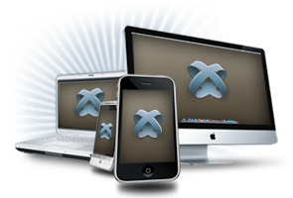
Agenda
About Me
Mobile Market Overview
Titanium Overview
Demo
Q&A
Notes:
THIS IS THE AGENDA

Slide 3
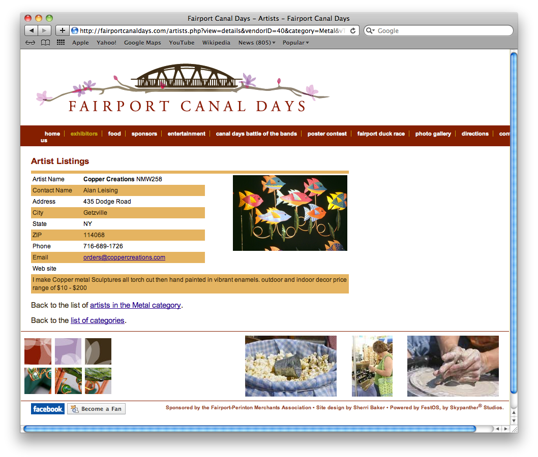
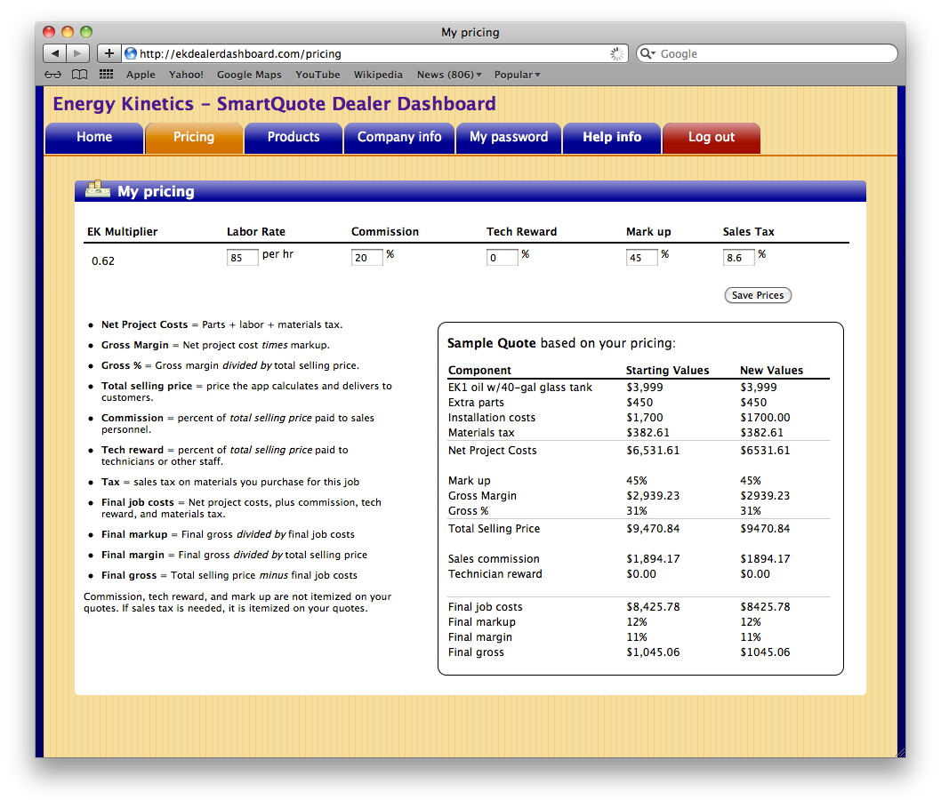
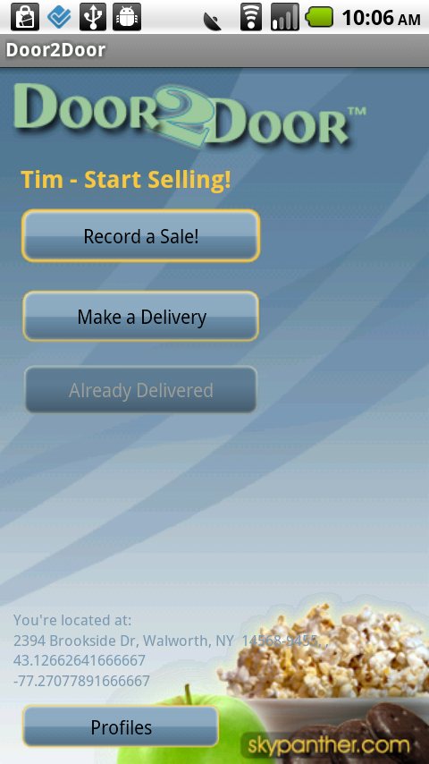
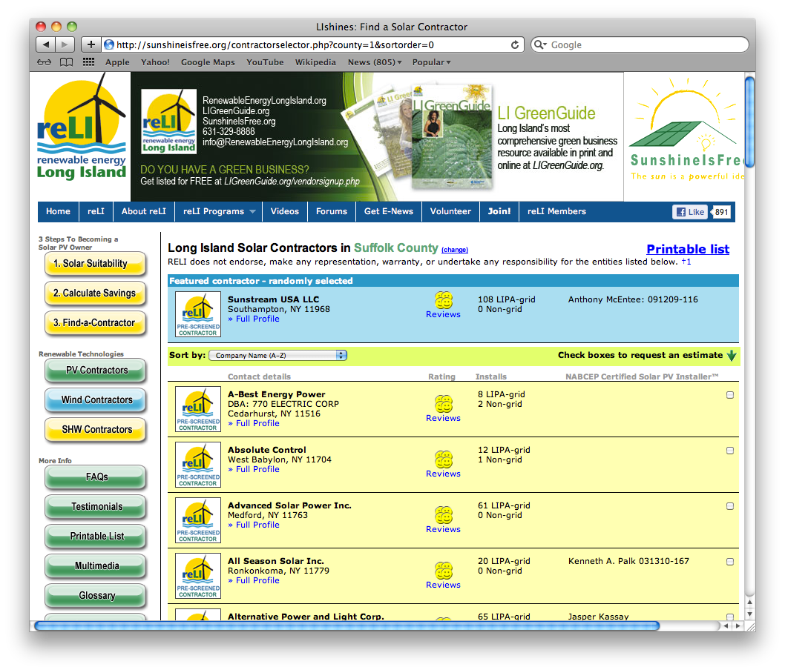
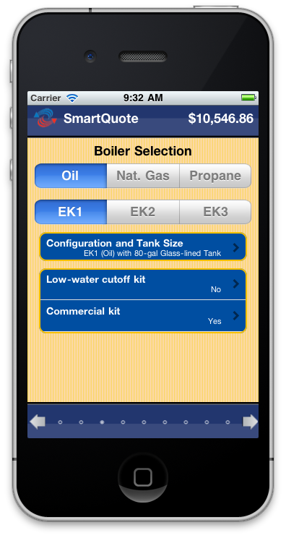
Me and my apps
About me
Skypanther
My apps
Appcelerator
Notes:
Background – 20+ years in computer education for companies like Logical Operations, Ziff-Davis Education, Element K, etc.
7+ years running Skypanther
PHP custom sites: RELI’s SunshineIsFree.org

Slide 4
The Mobile Market
 | iPhone/iPad | Android | Blackberry
# Apps (3/2011) | 400,000 | 225,000 | 27,000
App sales (2010) | $1.8 bn | $100 m | $165 m
Device market share (3/2011) | 20% | 40% | 12%
Lots of opportunity across platforms!
Notes:
The market potential is huge, no matter which platform you choose
But targeting all of them opens great new opportunities

Slide 5
Mobile Platform Development
iPhone / iPad – ObjectiveC
Android – Java
Blackberry – Java, HTML5
Notes:
But you have to re-develop for each
Multiple skill sets
Multiple development teams
Lots of time
Lots of money

Slide 6
HTML5 Web Apps
HTML UI + JavaScript + server backend
Limited access to device hardware
Limited data storage options (offline access)
Limited networking options
Notes:
One way people try to target all platforms is with web apps
But there are limitations

Slide 7
Titanium helps developers build apps that…
Run cross-platform
Look, feel, and perform native
Leverage common skill sets
Fit well in the native app ecosystem

Slide 8
Titanium is…
A JavaScript-based framework
With access to native OS and hardware features
Modular and extensible
Free
Notes:
You write your app in Javascript
And have access to a rich API set giving access to native OS and hardware features
Titanium is modular and extensible
It’s free and open source

Slide 9


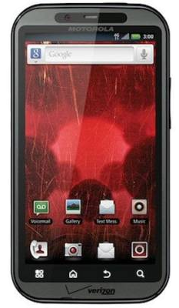
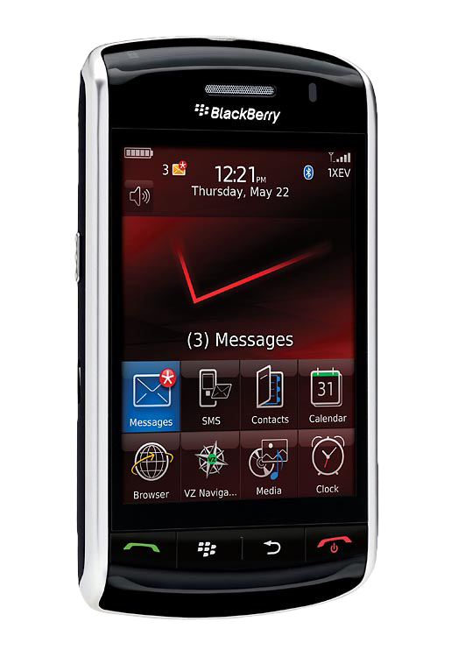
Titanium is cross platform
Notes:
iOS and Android now
Blackberry in beta
Windows Phone in the works

Slide 10
Look, feel, and perform native
Menus, hardware buttons, notifications, services
Hardware – GPS, camera, accelerometer, etc.
Networking – HTTPclient, sockets, Bonjour
Notes:
Titanium’s API gives you access to

Slide 11
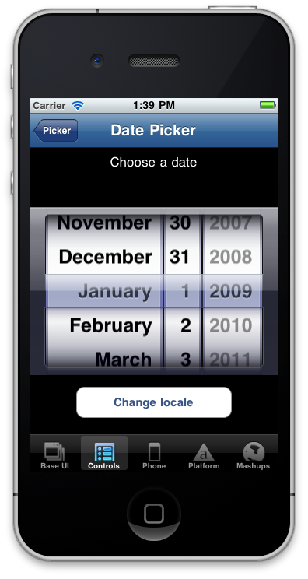
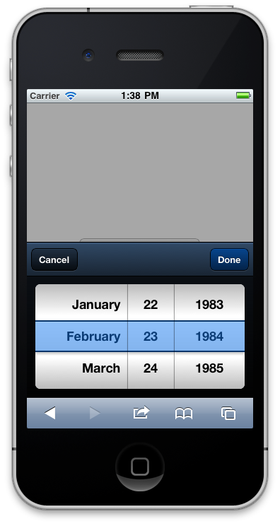
Titanium exposes native controls
Titanium
Not…
Notes:
You’re manipulating actual native controls via Javascript
Better user experience
Faster
You can skin most components for custom UI if you want

Slide 12
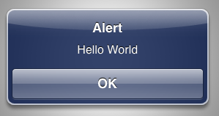
Titanium is easier
// Objective-C
UIAlertView *alert = [[UIAlertView alloc]
initWithTitle:@"Alert"
message:@"Hello World"
delegate:nil
cancelButtonTitle:@"OK"
otherButtonTitles:nil];
[alert show];
[alert release];
Notes:
Titanium lets you leverage skills you have already

Slide 13
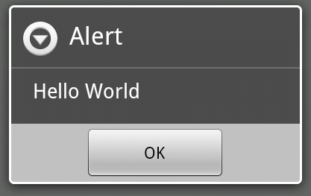
Titanium is easier
// Java/Android
AlertDialog.Builder builder = new AlertDialog.Builder(this);
builder.setMessage("Hello World")
.setCancelable(false)
.setPositiveButton("OK", new DialogInterface.OnClickListener() {
public void onClick(DialogInterface dialog, int id) {
MyActivity.this.finish();
}
});
AlertDialog alert = builder.create();

Slide 14
Titanium is easier
// Titanium
alert("Hello World");
… and it’s cross platform!

Slide 15








Titanium exploits the native ecosystem
Native User Experience
Native performance + Native UI
(tables, animations, gestures…etc.)
Multimedia
Camera, video camera,
streaming/device audio/video
Location-based services
Augmented reality, geolocation, compass, native maps
Analytics
Track usage patterns and adoption
Social sharing
Facebook, Twitter, Yahoo YQL.
Native email/address book
Titanium modules
Appcelerator Marketplace for add-on functionality
Data
Local SQLite, filesystem, properties data store, web services
Development tools
Titanium Studio, integration with native SDK tools

Slide 16
Publish to …
App stores:
Apple iTunes App Store
Google Android Market
Amazon AppStore (general Android, Kindle Fire)
Barnes & Noble Marketplace (Nook Color)
AppBrain and various third-party stores
US and International markets
Notes:
Amazon & B&N stores tend to target a different, more affluent demographic
More females
More likely to buy

Slide 17
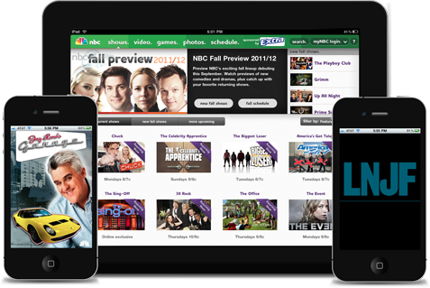
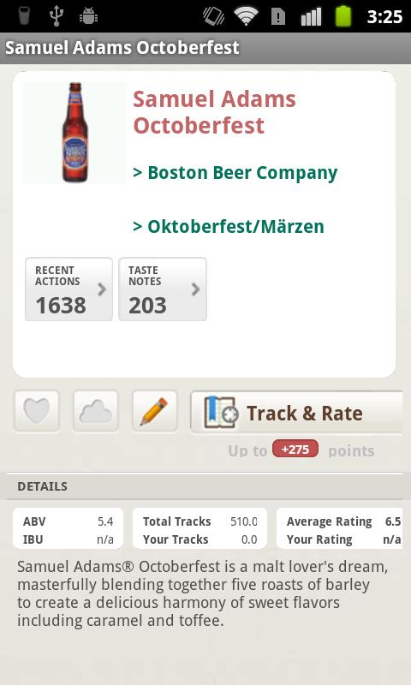
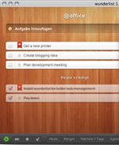
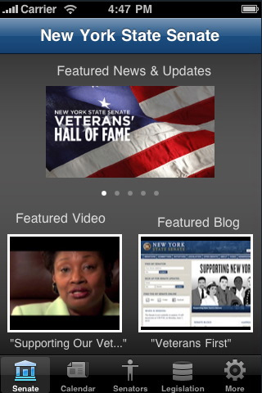
Powered by Titanium
Applications:
NBC apps
NYS Senate
Wunderlist
GetGlue
Companies:
Kellogg’s
NBC/Universal
eBay and PayPal
Anheuser Busch
Jaguar
… and many more
Notes:
200,000+ developers / 27,000 apps “in the wild”

Slide 18
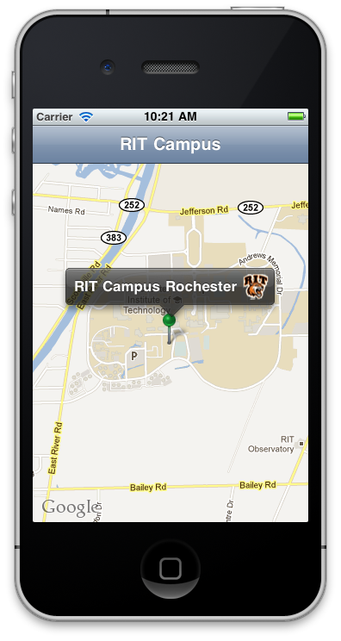
Demo
var map = Ti.Map.createView({
region: {
latitude:43.082602,
longitude:-77.676859,
latitudeDelta:0.01,
longitudeDelta:0.01},
animate:true,
regionFit:true
});

Slide 19
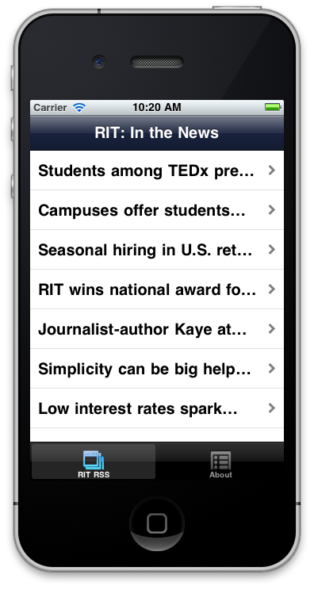
Demo 2
RSS reader
Modular architecture (CommonJS require() method)
HTTP calls and XML parsing
Event-based messaging
Web views
Notes:
In this demo, I’ll walk you through a more complex example
that uses a modular architecture
network interaction and XML parsing
application events to pass messages within the app
and HTML web views

Slide 20


Titanium at 10,000 feet
Your Application
Titanium APIs
Bridge (kroll)
Android
iOS
Notes:
At the top is your app – written in Javascript
At the bottom is the native OS and controls
In between are the kroll bridge and the API it exposes

Slide 21
Titanium Under the Covers
Leverages native development kits
JavaScript statically analyzed, native project stubs generated
JavaScript precompiled to bytecode (Android) or inlined in a generated C file (iOS)
Your JavaScript is interpreted at runtime via bundled JavaScriptCore (iOS) or Rhino/V8 (Android) engine
Notes:
You’ll need the Android and/or iOS SDKs, which means a Mac for iOS development

Slide 22
Let’s talk money
Apache 2.0 - free to download, use, and publish your apps
Subscription plans
Indie, Professional, & Enterprise
Pro services, SLA support, training
Modules Marketplace
http://www.appcelerator.com/products/plans-pricing/
Notes:
Subscriptions include access to modules, training materials, varying levels of support, analytics, etc.

Slide 23
Titanium is not …
Just a wrapper around HTML5 content
(though you can certainly do that if you want)
Write Once, Run Everywhere
(that tends to be “Write once, suck everywhere”)
A cross compiler
(it doesn’t create Obj-C / Java code for you)
Going to do the programming for you
(moderate JavaScript and fundamental programming skills are required)
Notes:
Titanium apps are built with JavaScript, run in a JS interpreter, and have access to local and remote content. But they’re not just web apps
Most all your backend code will be 100% portable. But UI is going to need tweaking. The platform models are just too different for WO/RE
Platform directories, branching in code, discrete namespaces, etc. help you build multiplatform code
A common misconception is that Ti creates objective C or java code
Going forward, Ti will require you to take more active management role in terms of loading required modules, managing memory, etc.

Slide 24
Resources
Eloquent JavaScript, JavaScript: The Good Parts
Download Titanium – www.appcelerator.com
Sample apps:
API demo: github.com/appcelerator/KitchenSink
Lots more at http://wiki.appcelerator.org/display/ guides/Example+Applications
Notes:
Learn Javascript, these are a couple of good references though there are lots more available
Sample apps
Kitchen Sink shows how to use APIs but it’s not a best practices app

Slide 25
Resources
wiki.appcelerator.org
developer.appcelerator.com
@appcelerator (and more)
#titanium_app (irc.freenode.net)
meetup.com/TiRochester

Slide 26
Questions?
Q&A
Tim Poulsen
Trainer & Curriculum Developer, Appcelerator, Inc.
tpoulsen@appcelerator.com
@skypanther

